Slide 1
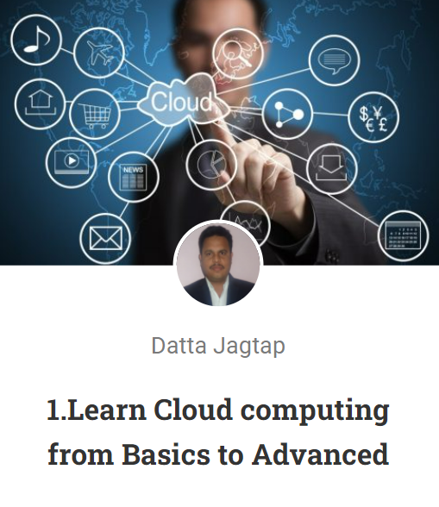
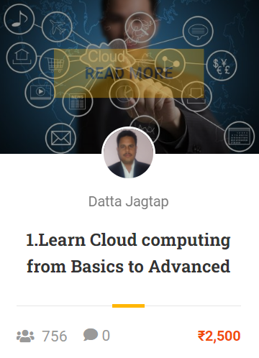
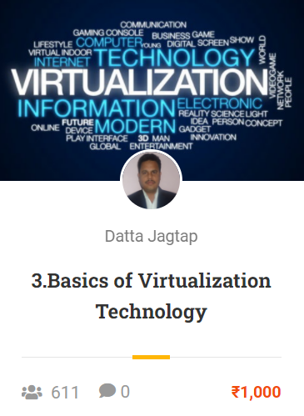
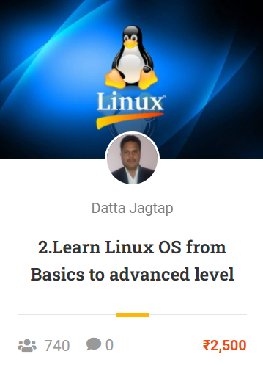

Slide 2

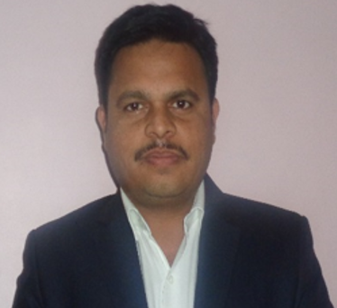
Learn Cloud Computing
from Basics to Advanced
Mr. Datta Jagtap
Certified Cloud Computing expert
From Amazon & Microsoft

Slide 3

Learn Linux
from Basics to Advanced
Mr. Datta Jagtap
Certified Cloud Computing expert
From Amazon & Microsoft

Slide 4
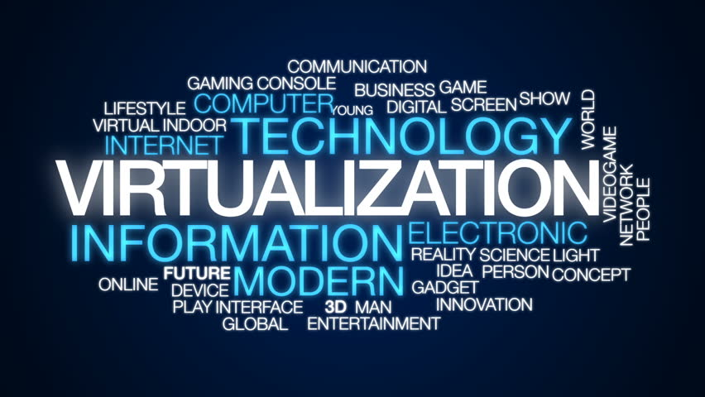
Basics of
Virtualization Technology
Mr. Datta Jagtap
Certified Cloud Computing expert
From Amazon & Microsoft

Slide 5

IP Addressing
&
Subnetting
Mr. Datta Jagtap
Certified Cloud Computing expert
From Amazon & Microsoft

Slide 6
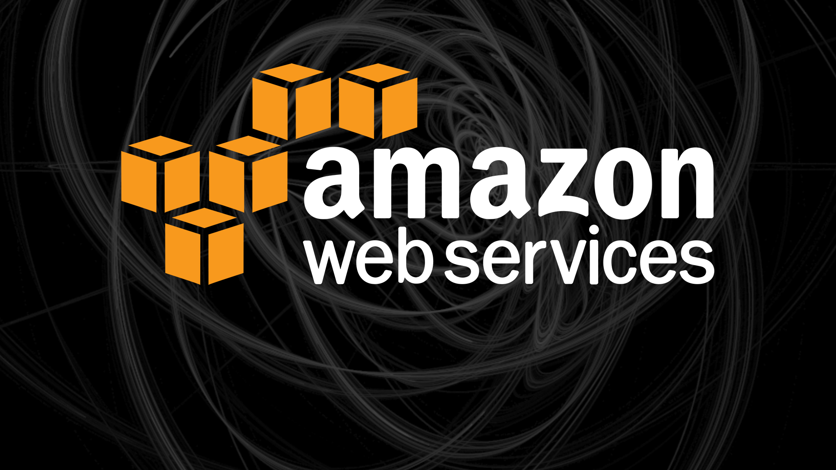
AWS Certified
Solution Architect-Associate
(SAA-C02)
Mr. Datta Jagtap
Certified Cloud Computing expert
From Amazon & Microsoft

Slide 7
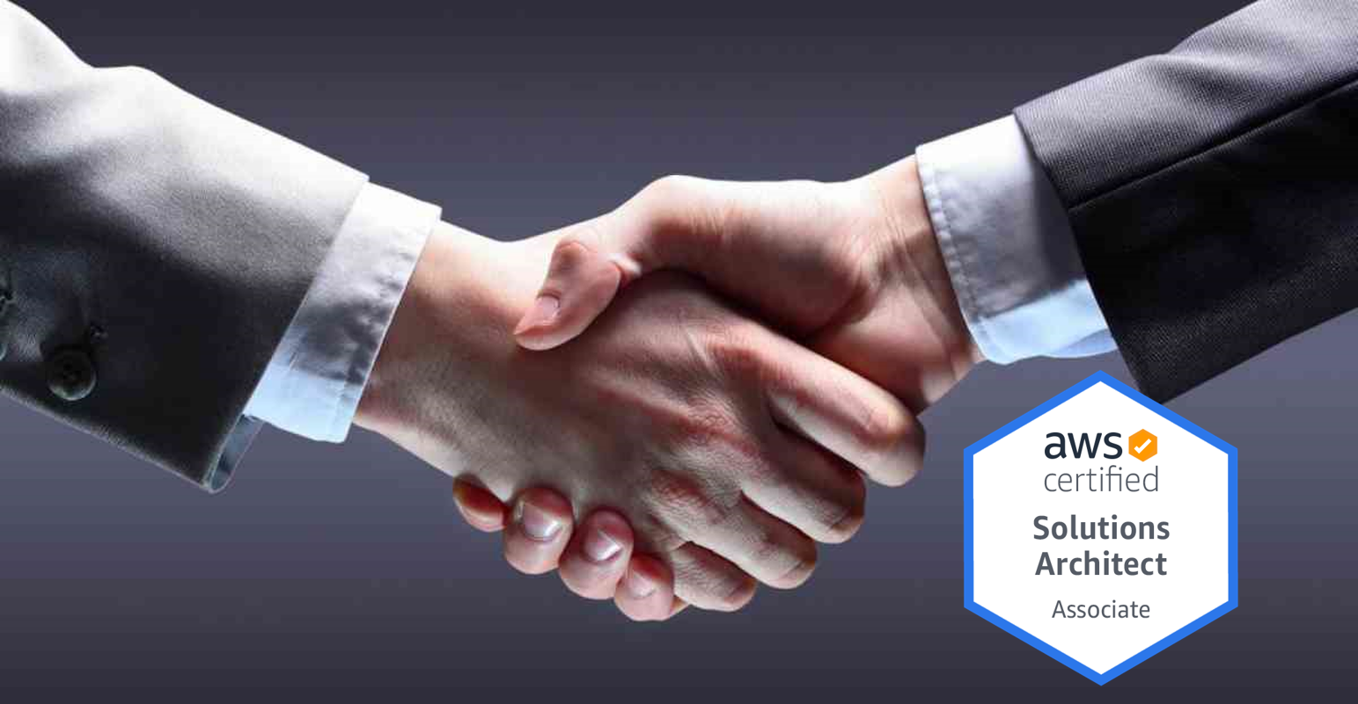
AWS Solution Architect
Interview Questions
Mr. Datta Jagtap
Certified Cloud Computing expert
From Amazon & Microsoft

Slide 8
AWS Solution Architect
Interview Questions
Mr. Datta Jagtap
Certified Cloud Computing expert
From Amazon & Microsoft

